Slide 1

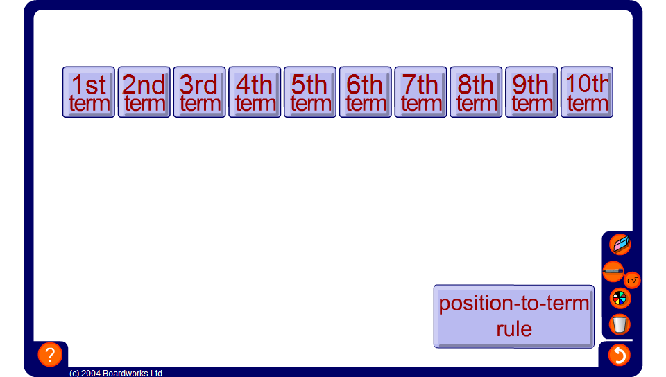


Sequence generator – non-linear sequences
Notes:
Use this activity to generate non-linear sequences.
Click on the position-to-term rule to edit it.

